Slide 1
Setting Out

Slide 2
Setting Out
The method of setting out is the reverse of surveying process.
The process involves the positions and levels of building lines and road alignments shown on the construction plans to be established on the ground by various techniques and instruments

Slide 3
Setting Out
Setting out buildings by coordinates
Setting out with theodolite and level
Checking verticality
Setting out and alignment in steel framed buildings
Alignment and verticality in formwork
Control and calculation for route surveying

Slide 4
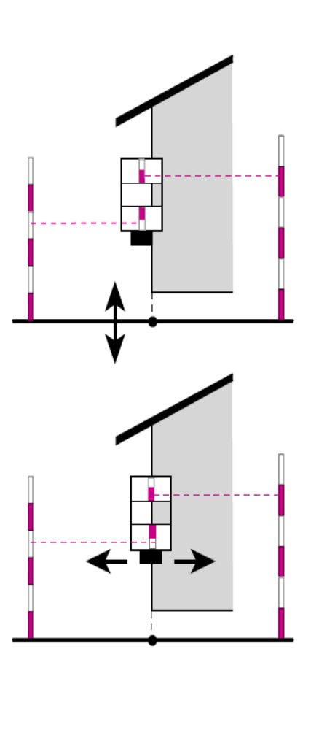
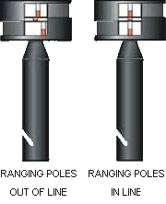
Measuring Right Angles:
Survey Prism, Optical Square

Slide 5
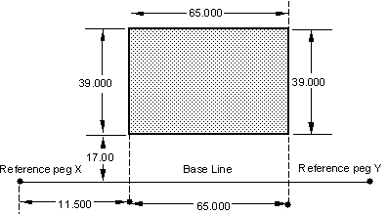
Setting out Buildings by Coordinates
A building site may be set out by referring to a baseline

Slide 6
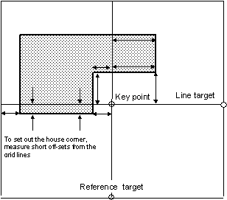
Setting out Buildings by Coordinates (cont.)
Setting out a complex building may require a site/survey grid to locate the building corners in terms of coordinates

Slide 7
Setting out Buildings by Coordinates (cont.)
Set up the theodolite over a key point and sight on a distant point on a chosen grid line
Set the reading to zero
Unclamp the top plate and turn the telescope 90º
Reclamp the top plate and bring the reading to either 90º or 270º
Direct a distant peg so that its position lies on this line
Observe the angle set out on both faces
Select and set out reference marks outside the working area

Slide 8
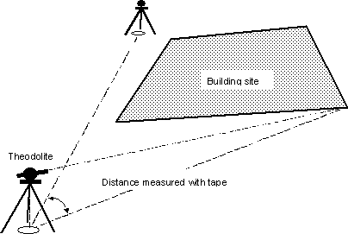
Setting out Buildings by Setting out with Theodolite
By bearing and distance

Slide 9
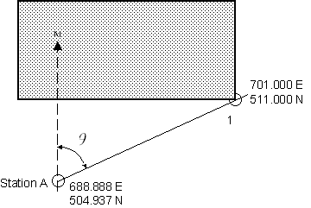
Setting out Buildings with Theodolite by the Intersection of Bearings from two Traverse Stations
Calculate the setting out data for points 1 from the traverse station A

Slide 10
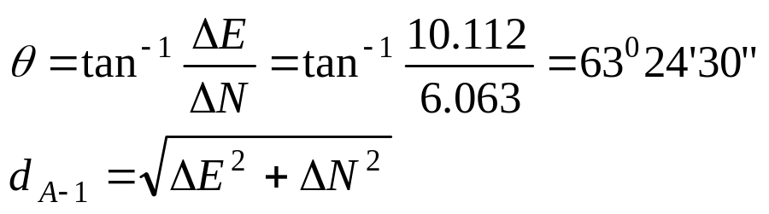
Setting out Buildings with Theodolite by the Intersection of Bearings from two Traverse Stations
Given:
Calculate: Bearing and distance A to 1 as
*Available from a plan or traverse computation
**It can be read from survey grid
 | Easting (m) | Northing (m)
Station A* | 688.888 | 504.937
Pt 1** | 701.000 | 511.000

Slide 11
Checking Verticality
Using
  Plumb bob
  Optical plummet
  Theodolite

Slide 12
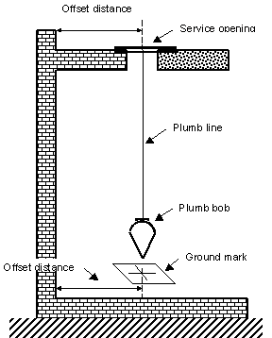
Verticality Using Plumb Bob
Useful for buildings less than 20 m in height
Use water or oil filled container to reduce oscillations of plumb bob for higher buildings

Slide 13
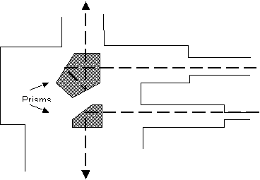
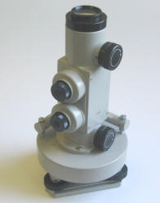
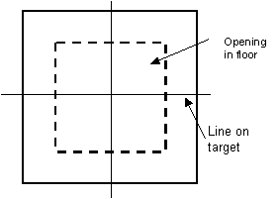
Optical Plummet
Instrument consists of two telescopes for sighting upwards and downwards. Their axes coincide with the direction of vertical
A transparent plastic sheet is used as a target for checking verticality of tall buildings
Positioned each corner of the building at lift wells or stair wells.

Slide 14
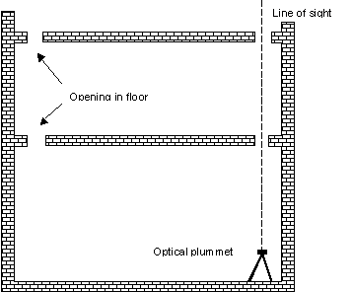
Verticality Using Optical Plummet
Checking verticality of tall buildings

Slide 15
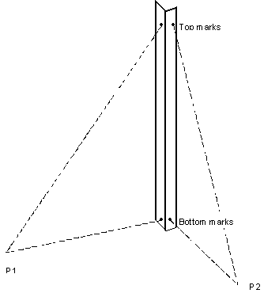
Verticality Using Theodolite
Set the theodolites on₁ P and P₂ then sight onto the bottom marks
Then sight onto the top marks
Instruments must be leveled and face-let and face-right reading should be made
Use an eyepiece for tall top marks

Slide 16
Setting Out Simple Curves

Slide 17
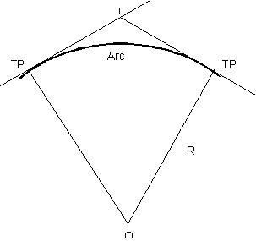
Simple Curve
O: center of circle
R: radius
I: point of intersection
TP: tangent point

Slide 18
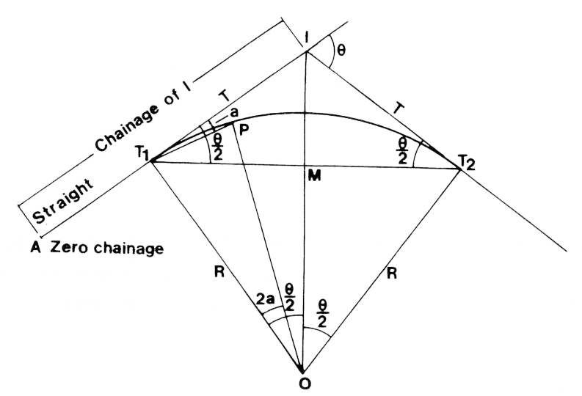
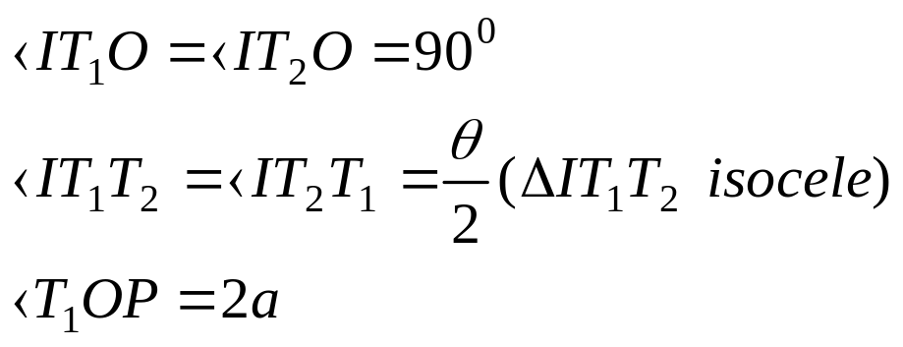
Simple Curve (cont.)
T: tangent to the curve
L: length of the curve (arc from T₁ to T₂)
T₁,T₂: tangent points
θ: deviation/intersection angle
M: midpoint of chord T₁ – T₂
a: deflection angle at T₁ to a point P on the curve

Slide 19
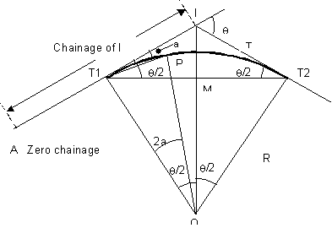
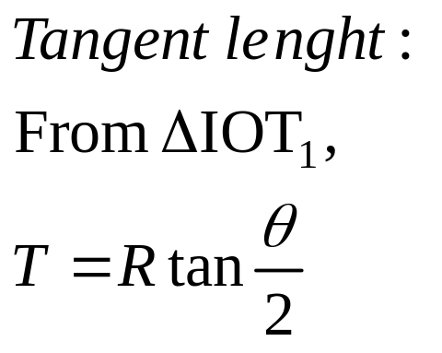
Simple Curve (Tangent Length)

Slide 20
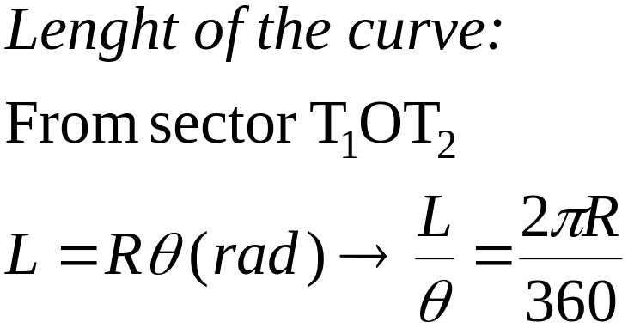
Simple Curve (Length of the Curve)

Slide 21
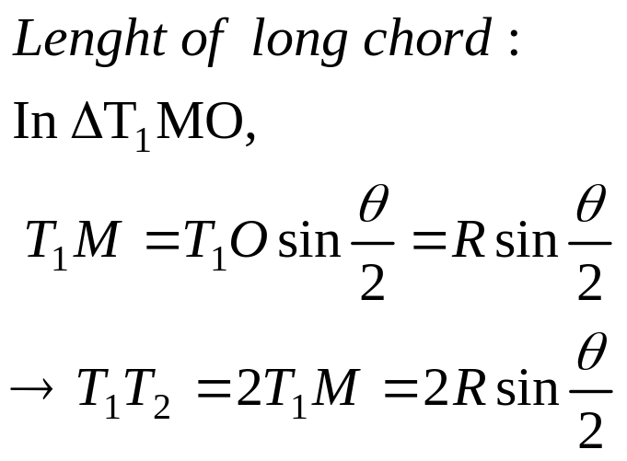
Simple Curve (cont.)

Slide 22
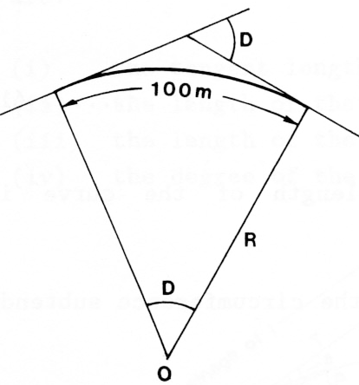
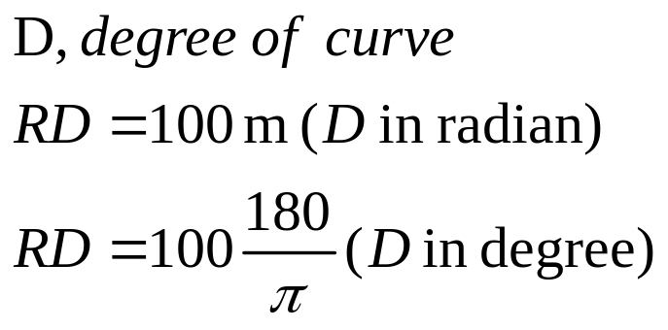
Simple Curve (cont.)
The degree of curve is defined as the angle subtended at the center O of a circle with radius R , by an arc T₁ T₂, of length 100 m

Slide 23
Simple Curve (cont.)
The location of the marks is referred to as the chainage along the center line of the road. In the figure, A is the point of zero chainage.
Example:
-The chainage of I is the distance AT1
-The chainage of AT2 is the distance AT1 plus the arc T1T2.

Slide 24
Field Setting Out
  Offsets from the Long Chord Method
  Offsets from the tangent method (less accurate)
  Deflection angle method, (accurate) or
  Two-theodolites method (accurate)

Slide 25
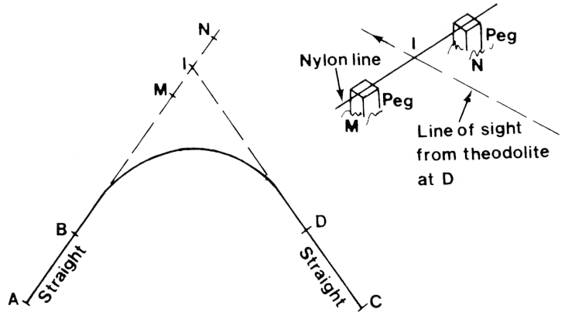
Location of Intersection Points

Slide 26

Steps for Locating Intersection Points
Set up theodolite at B orient at A
Transit the telescope and set out pegs M and N close to I
Same steps at D
The line of sight of the telescope now intersects the nylon line connecting the pegs M and N at I
Set up the theodolite at I and measure the angle DIB. The deviation angle is:

Slide 27
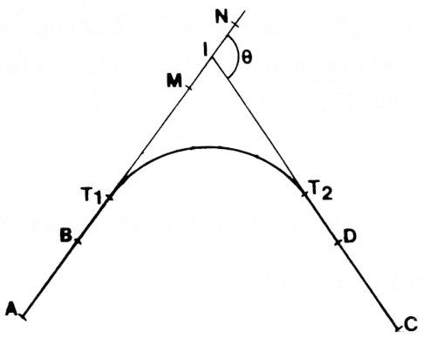
Location of Tangent Points
Calculate the tangent length
Set out the tangent points T1 and T2 on IB and ID respectively

Slide 28
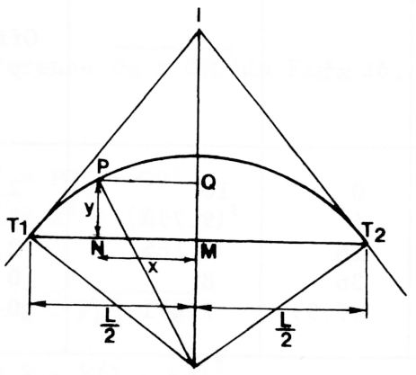
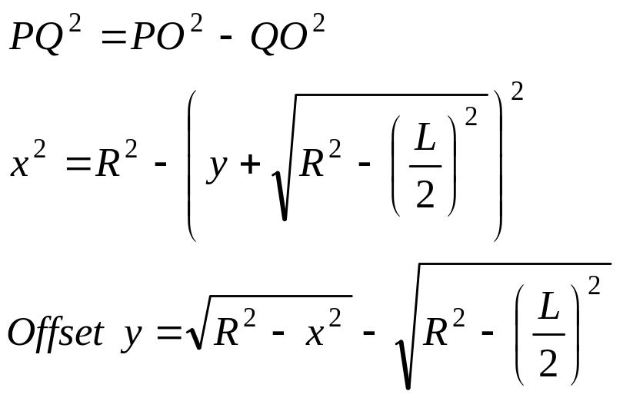
1 - Offsets from the Long Chord Method
Suitable for curves of small radius ➔ set out using tapes
Fix a peg M on the long chord mid-way between T1 and T2, L/2 from T1 and T2
Set out P by a perpendicular offset from the long chord

Slide 29
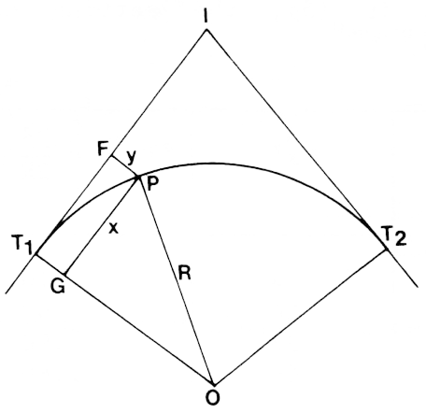
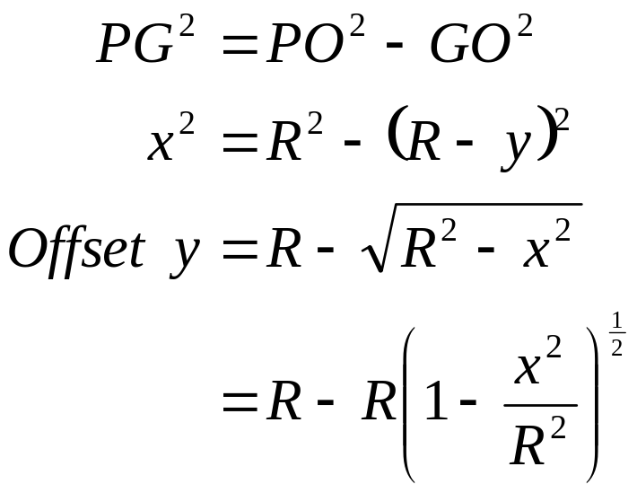
2 - Offsets from the Tangent Method
Erect offset y at right angles to F at a distance x from T₁
Use the tangent point T₂ for the other part.

Slide 30
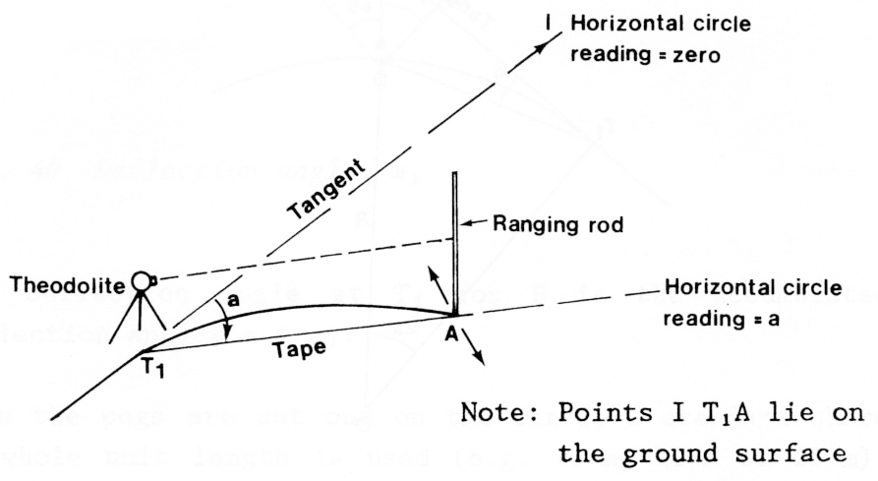
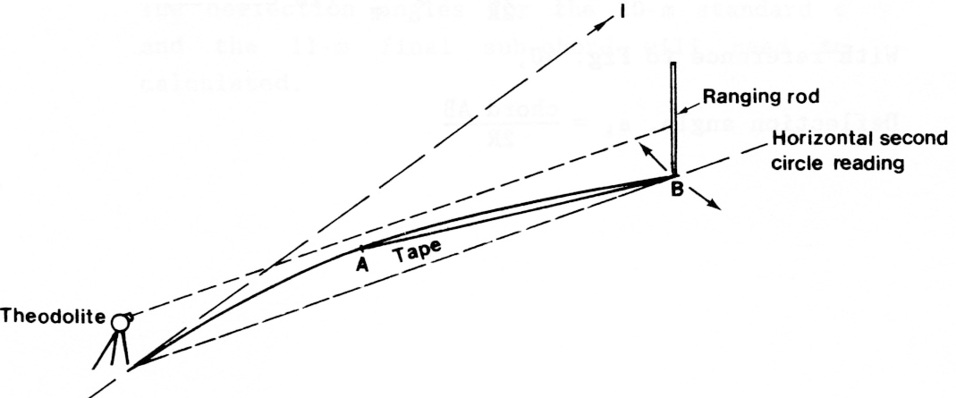
3 - Deflection Angle Method
For chord distance < R/20 m

Slide 31
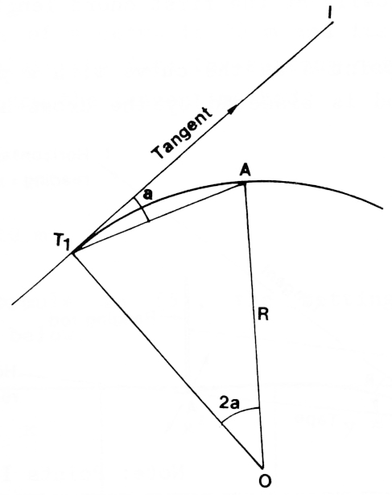
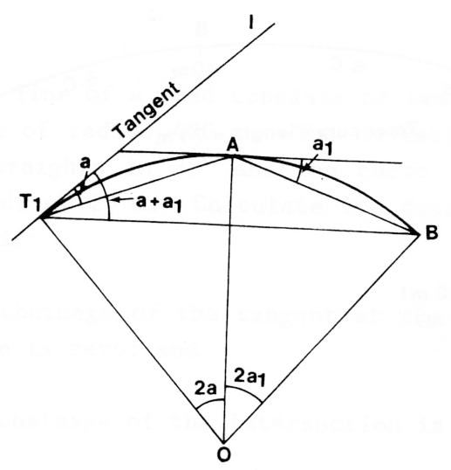
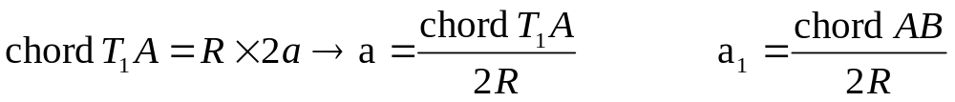
Deflection Angle a

Slide 32
Deflection Angle Method
Set theodolite at T1 and orient to intersection point I with horizontal circle set at zero
Release the upper clamp and turn the telescope until first circle reading appears on the circle
Set one end of the tape at T1 and swing the other and of the tape with a ranging rode held vertically at the first chord length
Mark the point A with a peg when the rod is bisected by the cross-hairs
Turn the theodolite so that it now sights point B and read the second circle reading
Pull the tape from A to B for the second chord length and peg out the next point B
Repeat the process for all remaining points.

Slide 33
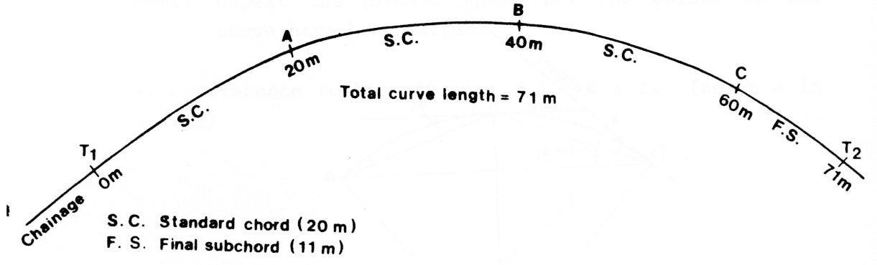
Chainage Curve
  When the chainage starts at 0 m, the pegs will be set at chainage 0 m, 20 m, 40 m, 60 m, and 71 m.
  20 m standard and 11 m final sub chord will need to be calculated separately.

Slide 34
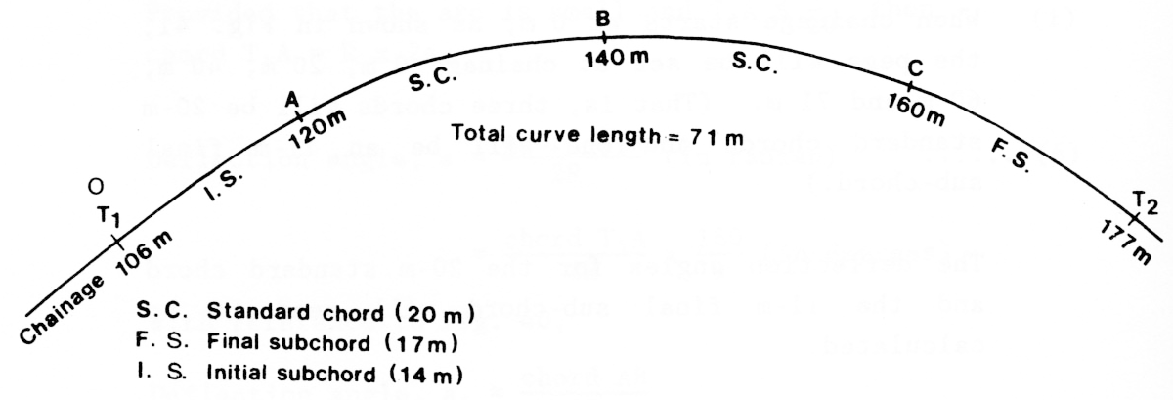
Chainage Curve
If the chainage does not start at 0 m, the pegs will be marked at chainage 106 m, 120 m, 140 m, 160 m, and 177 m
Initial, standard and final sub chords will need to be calculated separately

Slide 35
4- Two-theodolites Method
  The position of pegs can also be fixed on the curve by locating them as intersection points of the lines of sight from two theodolites
  The deflection angles are set out simultaneously from the tangent points T₁ and T₂.
  The two-theodolites method is suitable when direct linear measurement is difficult.

Slide 36
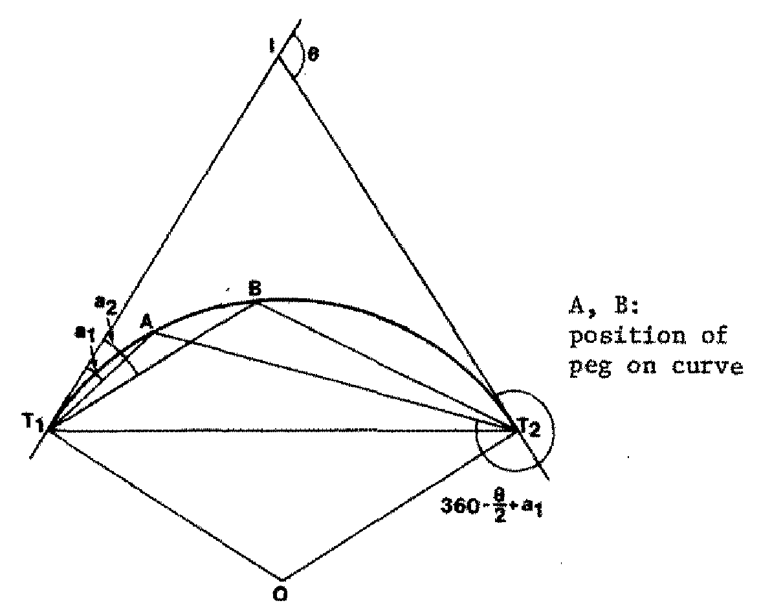
Two-theodolites Method

Slide 37
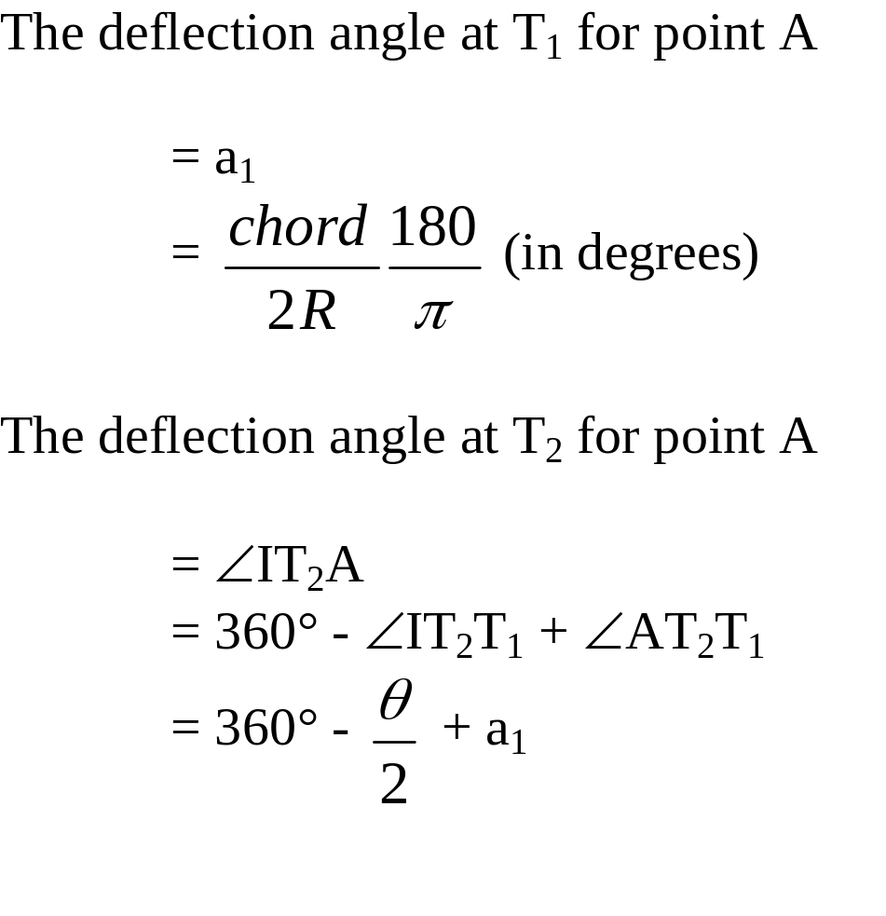

Two-theodolites Method

Slide 38
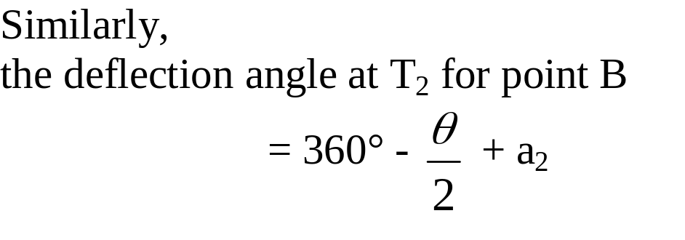
Two-theodolites Method

